Slide 1
Federated Learning

Slide 2
Introduction to Federated Learning (FL)
Collaborative machine learning where data remains decentralized on client devices.
Privacy, data security, regulation compliance

Slide 3
FL vs Traditional Centralized Learning
Compare centralized data collection vs decentralized training.
Benefits:
Privacy preservation
Reduced Latency
Bandwidth efficiency

Slide 4
Core Architecture of FL
Components:
Clients
Central Server
Workflow:
Model
Model updated
Local Training
Updates Aggregated

Slide 5
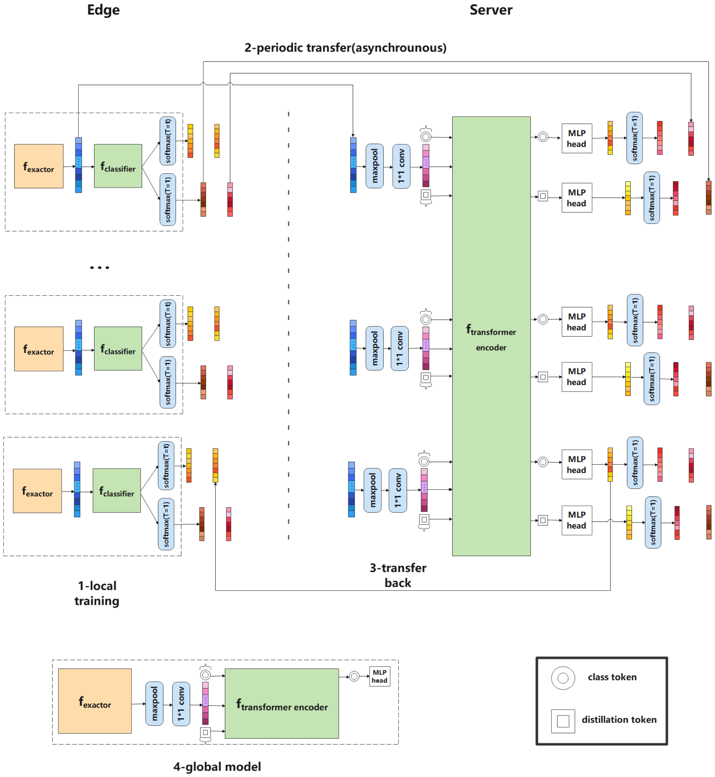
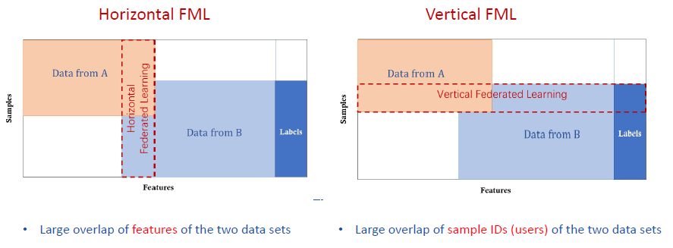
Types of Federated Learning
Horizontal FL
Vertical FL
Federated Transfer Learning
Source: https://www.crownpku.com/2019/03/13/A-Practical-Overview-of-Federated-Learning.html
Tao, J., Gao, Z., & Guo, Z. (2022). Training vision transformers in federated learning with limited edge-device resources. Electronics, 11(17), 2638. https://doi.org/10.3390/electronics11172638

Slide 6
Federated Optimizing Algorithms
Federated Averaging basics
Variations and improvements
Challenges with no – IID data and communication efficiency

Slide 7
Privacy and Security Measures
Techniques:
Differential Privacy
Secure Multiparty Computation
Homomorphic Encryption
Preventing data leaks via only sharing model updates

Slide 8
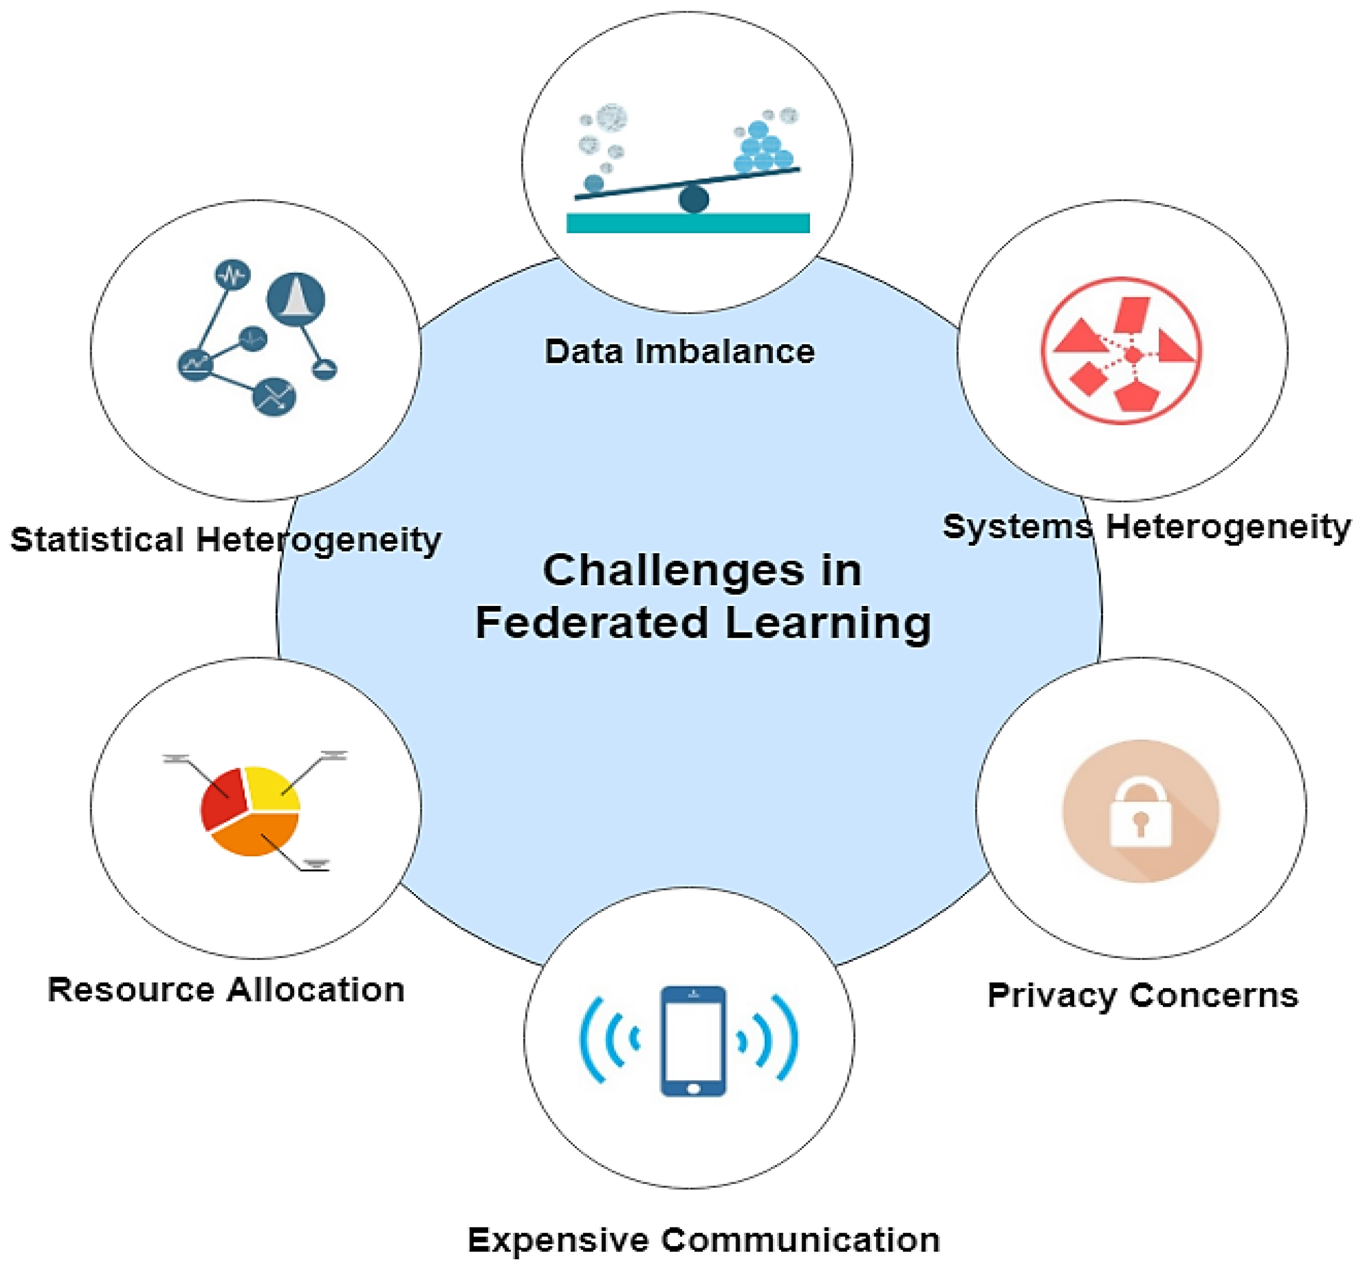
Challenges in Federated Learning
Data heterogeneity (non-IID)
Communication overhead
Client dropouts and unreliable connections
Security risks and adversarial attacks
Shaheen, M., Farooq, M. S., Umer, T., & Kim, B.-S. (2022). Applications of federated learning; taxonomy, challenges, and research trends. Electronics, 11(4), 670. https://doi.org/10.3390/electronics11040670

Slide 9
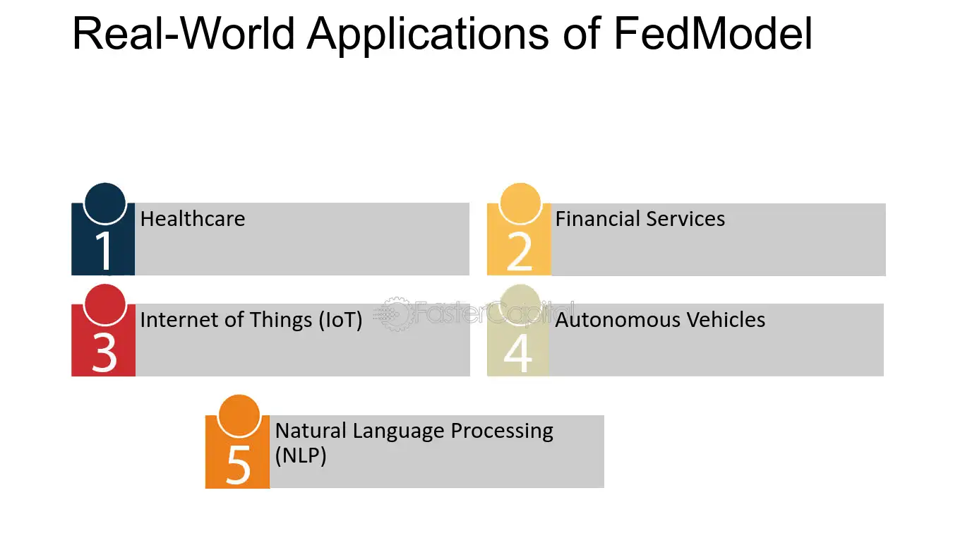
Real – World Applications
Healthcare: collaborative disease prediction without sharing patient data.
Finance: fraud detection across banks without exposing customer data.
IoT and mobile devices: personalized keyboard prediction, voice recognition.
Source: https://fastercapital.com/content/Unlocking-the-Potential-of-Federated-Learning-with-FedModel.html

Slide 10
Performance and Fairness Evaluation
Matrices:
Accuracy
Latency
Communication cost
Fairness across clients
Bias detection and mitigation in decentralized datasets.

Slide 11
Advanced Topics and Research Directions
Personalization and federated learning.
Robust federated learning under adversarial environments.
Scalability and system optimizations.

Slide 12
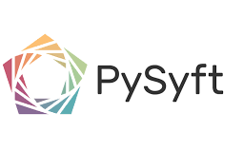
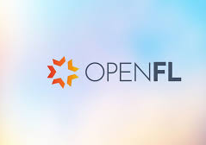
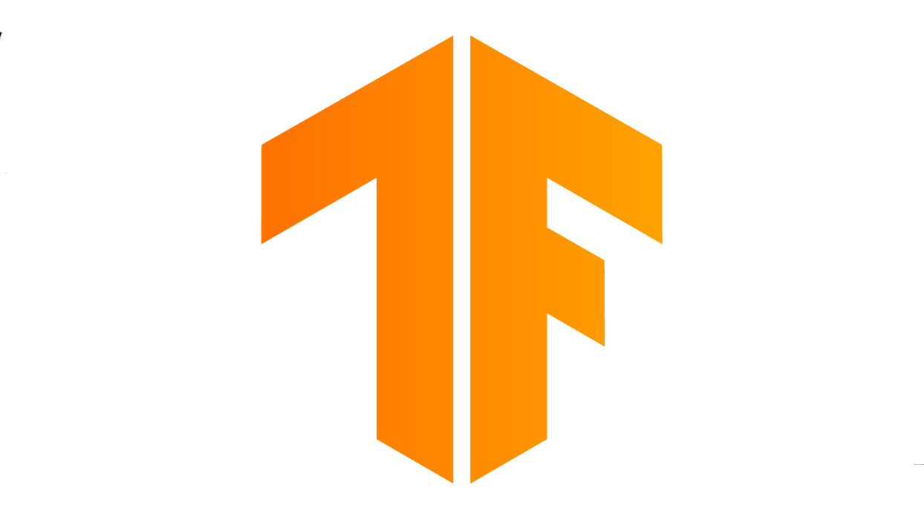
Federated Learning Tools and Frameworks
TensorFlow Federated
PySyft
OpenFL

Slide 13
Case Study of Implementation
McMahan et al. (2017) proposed federated learning to train models across decentralized devices or servers holding local data without centrally aggregating it, thereby preserving privacy. This method is relevant for sensitive call center data distributed across locations.
Methodology: Local model updates are aggregated centrally, minimizing raw data exchanges.
Techniques used to enhance security:
Differential privacy
Secure aggregation

Slide 14
Results: Effective decentralized training with privacy guarantees, though challenged by heterogeneous data and communication overhead.
Limitation: Model convergence and system complexity.
Reference: McMahan, B., Moore, E., Ramage, D., Hampson, S., & y Arcas, B. A. (207). Communication-Efficient Learning of Deep Networks from Decentralized Data. In Proceedings of the 20th International Conference on Artificial Intelligence and Statistics (AISTATS).

